Slide 1
Transformation

Slide 2
Transformation is….
A radical change of form.
Energy, chemical matter and living organisms can all undergo transformations.
EXAMPLES:
Chemical reactions
Metabolism
Puberty
Meiosis

Slide 3
What is a chemical reaction?
A transformation where reactants that a reaction starts with are changed into products.
Chemical reactions are a transformation that involves energy changes:
Exothermic: reactions that releases heat to the surroundings (increasing temp)
Endothermic: reactions that take in energy from its surroundings (decreasing temp)
Reactants → Products
Oxygen + Hydrogen → Water
MUST BALANCE EQUATION: O₂ + 2H₂ → 2H₂O

Slide 4
What effect does an enzyme have on a chemical reaction?
An enzyme is a biological catalyst, it lowers the amount of energy needed to get the reaction started (activation energy)
Enzymes are proteins, and like other proteins can be damaged at high temperatures or changes of pH.
Enzymes show enzyme-substrate specificity, therefore each type of enzyme acts in just one or a small group of reactions.
Enzymes usually end with ending -ase
Catalysts increase reaction rates without being changed themselves, so they are placed above the arrow in a chemical equation.
^{catalyst}
Reactants → products

Slide 5
https://www.youtube.com/watch?v=qgVFkRn8f10

Slide 6
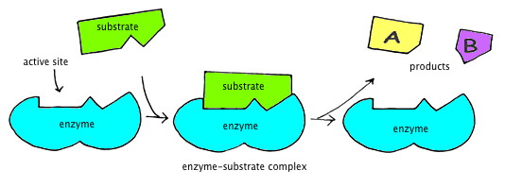
How do enzymes work?
Enzymes are proteins with a very distinctive 3-D structure.
Enzymes contain a region where reactants (substrates) can bind--this is called the active site

Slide 7
Naming Enzymes
A few enzymes have names with –in at the end, ex: pepsin and trypsin, but early on it was decided that enzymes should end in –ase.
Later, the International Union of Biochemistry decided that the name of an enzyme should tell us what the substrate of an enzyme is and the type of reaction catalyzed.
EXAMPLE: Malate dehydrogenase removes hydrogen from an organic acid called malate during aerobic respiration
What do these enzymes do?
Nitrate reductase
Iodotyrosine deiodinase
Phosphoglucose isomerase

Slide 8
What biochemical transformations happen inside our cells?
In a metabolic pathway, the substrate for the first reaction is transformed, via a series of intermediates, into the end product of the final reaction.
Examples:
Cellular respiration– Glucose is broken down to release energy
Lactose → glucose and galactose– Lactose is the sugar in milk, it is a disaccharide that is broken down by the enzyme lactase into two monosaccharide sugars, glucose and galactose.
Ethanol → ethanoic acid- Ethanoic acid can be used in cellular respiration as a source of energy.

Slide 9
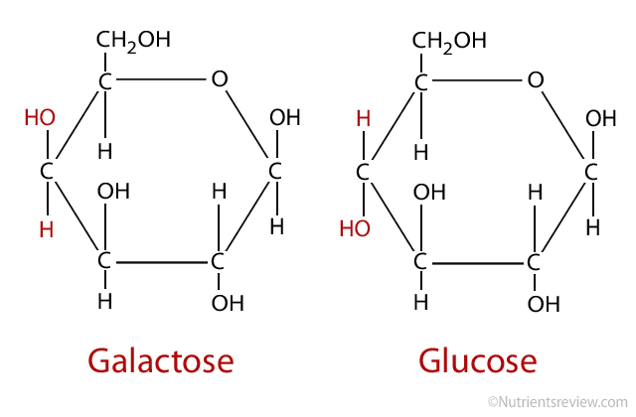
Critical Thinking Questions:
Describe the difference in structure between the two monosaccharide sugars glucose and galactose:
Lactose synthase is the enzyme which catalyzes the
Production of lactose, using glucose and galactose. Explain
the need for difference enzymes to synthesize and digest
Lactose.
Predict what will happen to lactose in the intestines of adults who do not produce the enzyme lactase.

Slide 10
What chemical transformations can other organisms do for us?
The chemical industry produces a wide range of chemical substances, using various factors, such as heat, pressure and catalysts to make transformations.
Bacteria are widely used because they grow quickly and are metabolically diverse
Plants make a huge range of different substances and can easily be grown
Animals are less common because of ethical problems with their use.

Slide 11
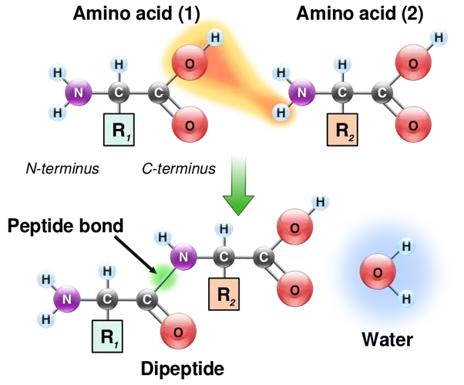
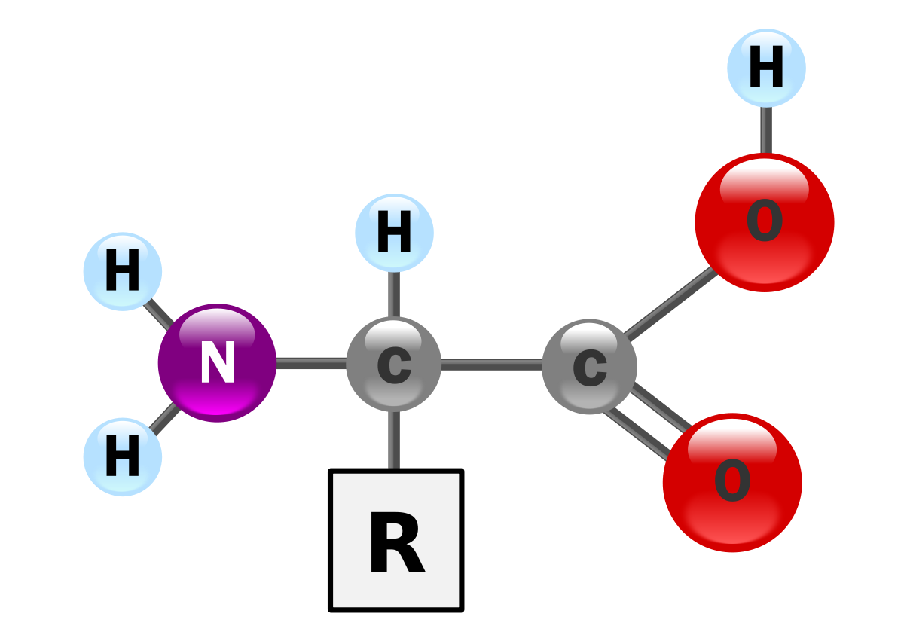
How does a cell transform amino acids into proteins?
Proteins are chains of amino acids linked by peptide bonds.
An amino acid’s structure looks like below: Amino acids join together below:
Amino group (-NH₂), Carboxyl group (-COOH),

Slide 12
Making Proteins Continued:
Protein Synthesis Background:
In order to make a particular protein, amino acids have to be linked together in the correct sequence
There are 20 different amino acids, each with a different R group
The information needed to make a protein is stored using genes, made of DNA.
A gene contains a linear sequence of the four DNA bases: (A) adenine, (C) cytosine, (G) guanine and (T) thymine
A-T pair together, C-G pair together

Slide 13
Protein Synthesis
DNA must be replicated before the first stage in protein synthesis. This occurs in the nucleus.
The first stage in protein synthesis is copying the base sequence of a gene in a process called transcription.
The copy is made of RNA which will have a base sequence identical to that of the gene, with one exception: RNA uses (U) uracil instead of (T) thymine.
This copy of RNA is called messenger RNA (mRNA) and take the sequence outside the nucleus to the ribosome.

Slide 14
Protein Synthesis Continued
The second stage in protein synthesis is the transformation of mRNA into the amino acid sequence of a protein.
This is called translation. Transfer RNA (tRNA) is required to bring in the amino acid sequence into the ribosome.
The mRNA sequence is matched up with the tRNA and the amino acids are linked by peptide bonds until a stop codon is reached.
A codon is a 3-base sequence such as AUG, located on mRNA
An anti-codon is the matching 3-base sequence, UAC, located on tRNA

Slide 15
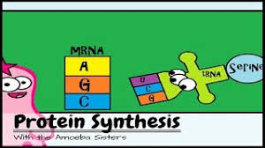
https://www.youtube.com/watch?v=h5mJbP23Buo

Slide 16
Show data-based question: GnRH on page 45 of textbook.

Slide 17
What is metamorphosis in animals?
Incomplete metamorphosis: insects such as locusts, grasshoppers and dragonflies undergo a series of abrupt changes to their body form.
Complete metamorphosis: insects such as beetles, bees and butterflies start life as a fertilized egg, which hatches out into a larva.
This type of cycle involves one major body change.

Slide 18
DBQ: Metamorphosis in the Western Spadefoot Toad
Calculate the difference in body mass between the groups raised in high and low water
Explain the difference in body mass
Using all the data in the table, explain how Western Spadefood toads tadpoles respond to low-water environment
Suggest advantages to the Western Spadefoot toad of being able to metamorphose at different times in response to water levels.
 | High Water | Low Water
Time taken to reach same stage of metamorphosis (days) | 133 | 90
Body mass at metamorphosis (grams) | 1.9 | 1.2
Corticosterone concentration (pg/cm³) | 210 | 380
Thyroid hormone concentration (pg/cm³) | 3.5 | 16.5
Thyroid hormone receptor levels | 225 | 325

Slide 19
What stages occur in all sexual life cycles?
Gametogenesis: Production of male and female sex cells (gametes).
Male gametes: Sperm Female gametes: ova (eggs)
Fertilization: Fusion of male and female gametes to produce a zygote.
During fertilization the chromosome # is doubled.
Example: Human gametes contain 23 chromosomes, so the zygote produced by fertilization contains 46 chromosomes.
Meiosis: Cell division used to halve the chromosome number.
Start with 46 chromosomes in a cell, end with 23 chromosomes in each cell.
Start with 1 cell, end with 4 cells.

Slide 20
Fertilization
https://www.youtube.com/watch?v=0lu9MEqZnvs

Slide 21
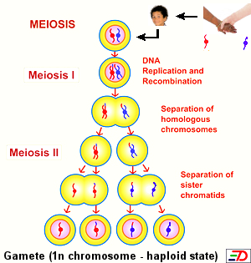
Meiosis
Meiosis begins with a diploid (2n) number of chromosomes and ends with a haploid (n) number of chromosomes. 46 → 23
Before Meiosis begins, all DNA molecules are replicated so each chromosome consists of 2 identical DNA strands.
This allows for meiosis to produce 4 haploid cells,
with the # of chromosomes halving during
the first of two divisions.

Slide 22
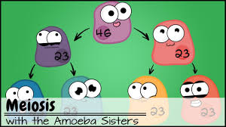
https://www.youtube.com/watch?v=VzDMG7ke69g&feature=youtu.be

Slide 23
How does sexual reproduction change combinations of genes?
Genes from the mother and the father come together, producing a combination that has probably never existed before.
Each parent contributes one of each chromosome type and so passes on one copy of each gene.
A zygote has 2 copies of each gene (one from mom, one from dad) except for males who have XY sex chromosomes.
During Meiosis, only one copy of the gene is passed on, creating a higher genetic variability.

Slide 25
Critical Thinking Questions:
Identical twins have the same combinations of genes as each other. Consider this hypothesis: Identical twins are the result of two sperms with identical combinations of genes fertilizing two eggs with identical combinations of genes.
Is this likely? If not, can you suggest a better hypothesis?
If a cell with different versions of two genes carries out meiosis, there are four possible combinations of genes in the cells produced. Calculate the number of possible combinations for each of these genes with different versions:
3
4
10
1,000

Slide 26
Critical Thinking Questions:
If identical twin men married identical twin women, would all their offspring be the same?
Explain the reasons for greater genetic diversity among children of mixed-race parents, compared with same-race parents.

Slide 27
Biodiversity Video:
https://www.youtube.com/watch?v=GK_vRtHJZu4

