Slide 1
The Five Senses

Slide 2
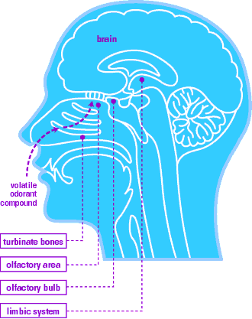
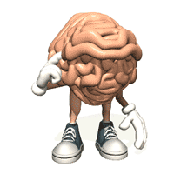
What parts of the body give us our sense of taste?
The Sense of Taste
Tongue
Brain
Nose

Slide 3
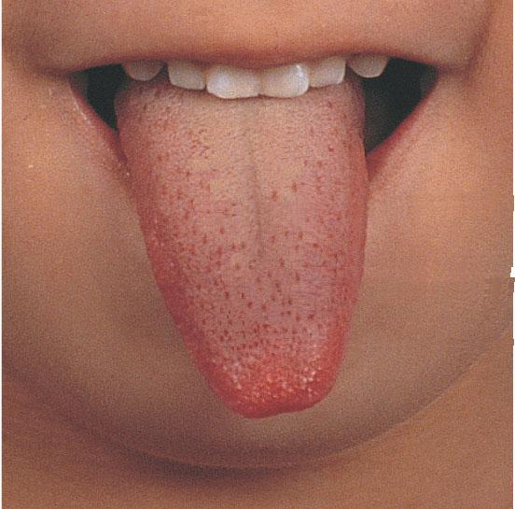
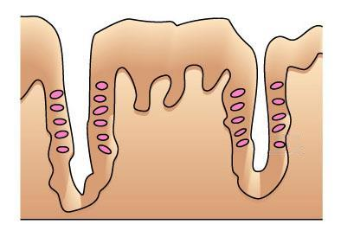
The Tongue
- Tongue is the sense organ that detects flavor.
many grooves on the surface
- Inside the grooves there are many taste buds which are taste receptors.

Slide 4
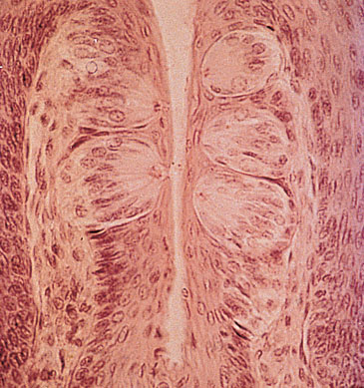
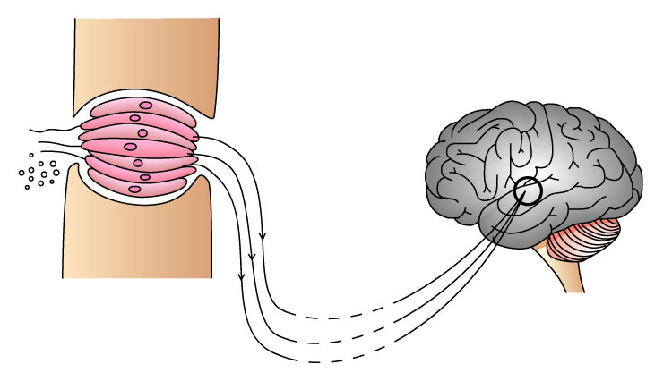
Magnified
Papillae
taste bud
Microscopic view of taste buds (x100)
sensory cell
food
brain

Slide 5
The Sense of Taste
What are the three functions of the tongue?
Eat
The tongue moves and pushes a small bit of food along with saliva into your esophagus, which is a food pipe that leads from your throat to your stomach.
Speech
Taste
The top of your tongue is covered with a layer of bumps called papillae
. Papillae help grip food and move it around while you chew.
They contain your taste buds, so you can taste everything.

Slide 6
Process to taste food
Flavoring chemicals in food dissolve in the saliva
Stimulates the taste buds to send messages to the brain.
Messages are sent to the brain to give us the taste of the food
sensory cell
chemicals in food

Slide 7
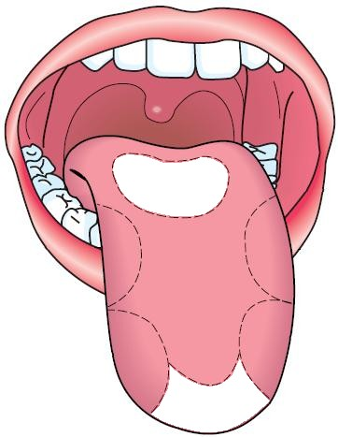
Humans have four kinds of taste buds.
They can detect four kinds of tastes: sweet, sour, salty and bitter.
- Each kind of taste buds is not evenly distributed on the tongue. Thus, certain parts of the tongue are more sensitive to a particular taste than the others.
bitter
sour
salty
sweet

Slide 8
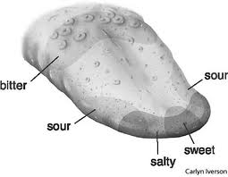
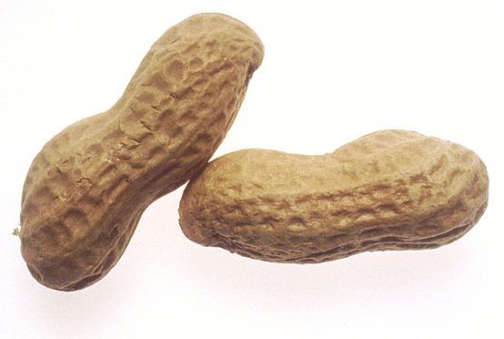
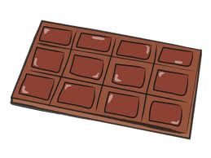
The Sense of Taste
Areas of Taste on the Tongue

Slide 9
What parts of the body give us our sense of Smell?
The Sense of Smell
Nose
Brain

Slide 10
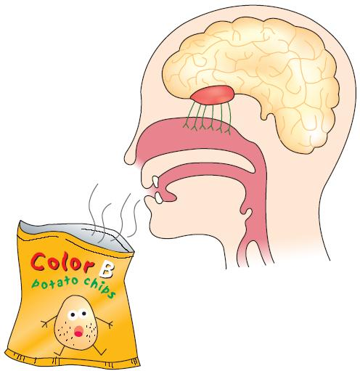
How do we smell ?
Nose is the sense organ that detects smell.
There are millions of smell receptors inside our nose.
nasal cavity

Slide 11
What are the functions of the Nose?
The Sense of Smell
Smell
Breathe
Taste

Slide 12
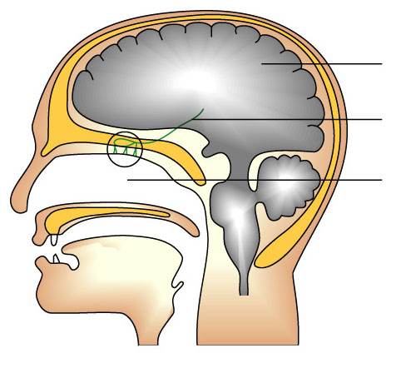
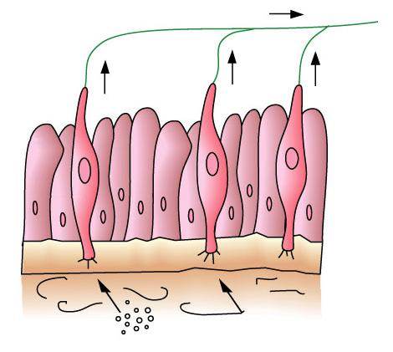
Magnify
Brain
nerve
nasal cavity
mucus lining inside
sensory cell
chemicals in food

Slide 13
Process to smell food
When we breathe, some chemicals enter our nose
=> chemicals dissolve in the mucus
=> stimulate the smell receptors to produce messages
=> These messages are sent to the brain to give us the odor of the food.
Some chemicals in the food diffuse into the air.

Slide 14
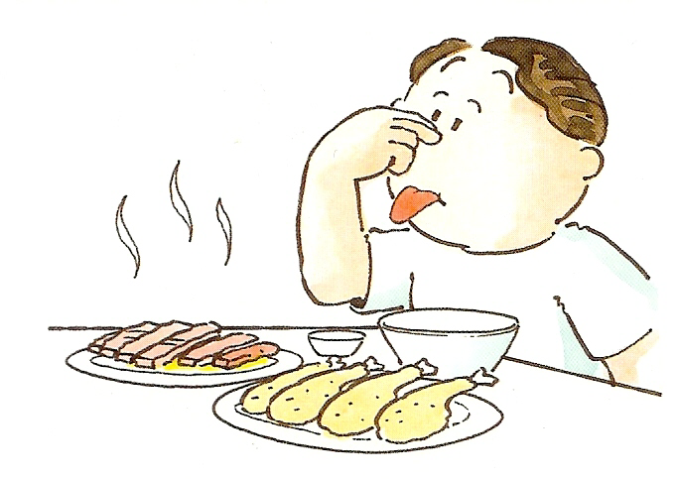
We use both smell and taste to detect the flavor of food.
Holding your nose can help take away unpleasant taste of food.

Slide 15
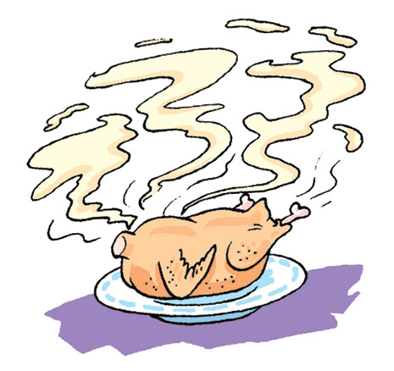
Do you know ?
Why do warm foods have stronger flavor than cold foods?
This is because when food is heated, more chemicals in food diffuse into the air.

Slide 16
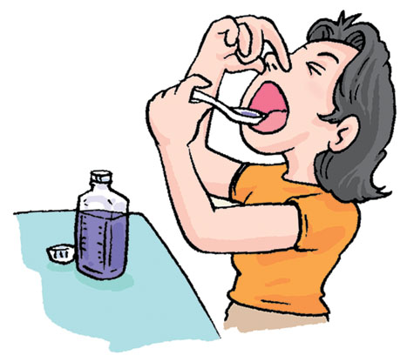
Some medicine is unpleasant to take.
You can hold your nose while taking the medicine. This helps take away the unpleasant feeling.

Slide 17
Our tongue can only distinguish about 4 different tastes. But our nose can distinguish about 4000 different chemicals.
Our nose can tell us not only the sweet taste of ice-cream, but also whether it is chocolate flavour or not.
Thus, when our nose is also used to sense the food, the food ‘tastes’ better.

Slide 18
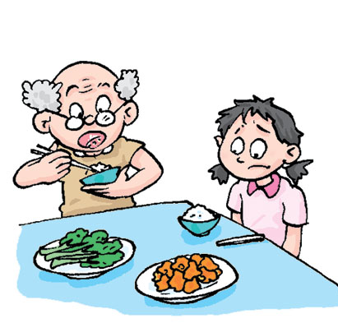
Do you know ?
Why do the elders like to take in food with strong flavor?
It’s too salty!

Slide 19
This is because the senses of smell and taste of the elders are weaker.
Food with strong flavor tastes good to the elders.

