Slide 1
The Senses
“Sights and Sounds”

Slide 2
Anatomy A-Day 2/28/20
Bellringer
Why are the last 2 ribs called “floating ribs”?
What bone allows you to say “yes”?
Agenda
Bellringer
Test Recap
Eye and Ear Notes
Label Eye and Ear
Cochlear Implant Reading

Slide 3
Anatomy A-Day 2/28/20
Bellringer
Why are the last 2 ribs called “floating ribs”?
- They only connect to the thoracic vertebrae in the back
What bone allows you to say “yes”?
Atlas
Agenda
Bellringer
Test Recap
Eye and Ear Notes
Label Eye and Ear
Cochlear Implant Reading

Slide 4
Anatomy A-Day 3/3/20
Bellringer
Which external part of the eye produces tears?
What is the name of the disease that is nearsightedness?
Agenda
Bellringer
Cochlear Implant Reading
Music Memory Writing Assignment
Nose-stalgia Lab Activity

Slide 5
Anatomy A-Day 3/3/20
Bellringer
Which external part of the eye produces tears?
Lacrimal Glands
What is the name of the disease that is nearsightedness?
Myopia
Agenda
Bellringer
Cochlear Implant Reading
Music Memory Writing Assignment
Nose-stalgia Lab Activity

Slide 6
Anatomy A-Day 3/5/20
Bellringer
What is the outer part of the ear called?
What is the liquid layer between the retina and the lens called?
Agenda
Bellringer
Finish Nose-stalgia
Tongue Notes
Taste Test Lab
Optical Illusions

Slide 7
Anatomy A-Day 3/5/20
Bellringer
What is the outer part of the ear called?
Auricle/Pinna
What is the liquid layer between the retina and the lens called?
Vitreous Humor
Agenda
Bellringer
Finish Nose-stalgia
Tongue Notes
Taste Test Lab

Slide 8
Anatomy A-Day 3/9/20
Bellringer
What is the white part of the eye called?
What is the black part of the eye called?
Agenda
Bellringer
Eye Anatomy Review
Cow Eye Dissection

Slide 9
Anatomy A-Day 3/9/20
Bellringer
What is the white part of the eye called?
Sclera
What is the black layer of the eye called?
Retina
Agenda
Bellringer
Eye Anatomy Review
Cow Eye Dissection

Slide 10
Anatomy A-Day 3/11/20
Bellringer
What is the function of papillae on the tongue?
Where are the taste buds for bitter found on the tongue?
Agenda
Bellringer
Skin Notes
Skin Label
Crash course video

Slide 11
Anatomy A-Day 3/11/20
Bellringer
What is the function of papillae on the tongue?
To grip food
Where are the taste buds for bitter found on the tongue?
In the back
Agenda
Bellringer
Skin Notes
Skin Label
Crash course video

Slide 12
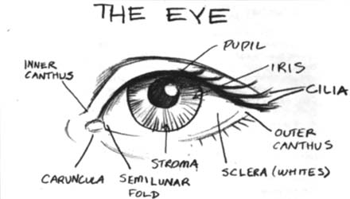
Anatomy of External Eye
Eyes protected by eyelids, which meet at canthus
Eyelashes at borders
Tarsal glands – secrete oil that lubricates eyes
Conjuctiva lines the eyelids and secretes mucus to lubricate eyeball
Lacrimal glands secrete tears (salt solution)

Slide 13
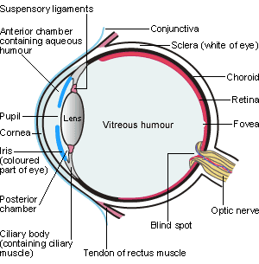
Anatomy of Inner Eye
Three Layers:
Fibrous Layer:
Sclera – white part
Cornea – transparent
Vascular Layer:
Choroid – nutritive tunic
Ciliary Body – lens attached by suspensory ligament
Iris – pigmented region, regulates amount of light
Pupil – light passes thru

Slide 14
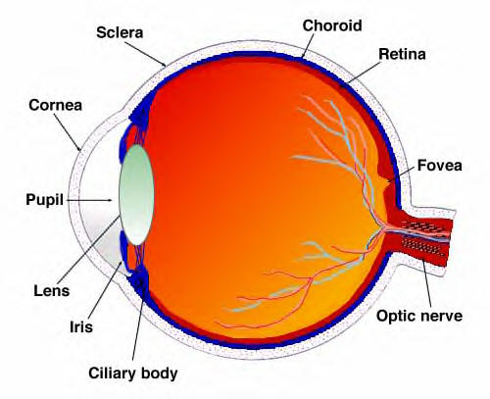
Anatomy of Inner Eye
3. Sensory Layer:
Retina – absorbs light
Stores Vitamin A
Contains photoreceptors – rods and cones
Optic Nerve – sends signal to CNS
Blind Spot /Optic Disk– where optic nerve leaves eyeball
Fovea centralis – pit next to blind spot with cones

Slide 15
Vision
Light is present
Waves of light enter eye through cornea, aqueous humor (fluid of inner eye), and lens.
Lens is used to focus (refract) light rays onto retina. Process called accommodation.
Image formed is a real image – reversed left to right, upside down, and smaller than object
Iris adjusts pupil to control amount of light
Photoreceptors collect info and send it along optic nerve to occipital lobe for interpretation

Slide 16
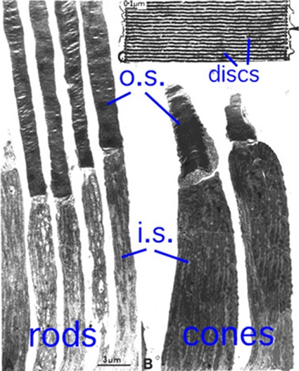
Rod Cells
Contain protein called rhodopsin
Rhodopsin absorbs photons of light energy
Rhodopsin changes shape which triggers a cascade of reactions that alter ion activity
Ion changes trigger an action potential
Used during dark conditions (for black and white vision)

Slide 17
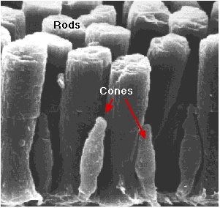
Cone Cells
Responsible for seeing in color. (Interpretation of color occurs in brain not in retina)
Three varieties of cones, each one sensitive to a particular wavelength of visible light: blue, green, and red.
When all three are stimulated, we see white.
Color blindness – occurs when person lacks cones of certain type, or all three.

Slide 18
Eye Health
Emmetropia – eye that focuses images correctly on retina
Myopia – nearsightedness. Light fails to reach retina, can only see close objects.
Hyperopia – farsightedness. Light focused behind retina, can only see far away objects.
Astigmatism – unequal curvatures in lens/cornea
Glaucoma – pressure within eye when aqueous humor is blocked, leads to compression of nerve
Cataracts – hardened lens, leads to hazy vision

Slide 19
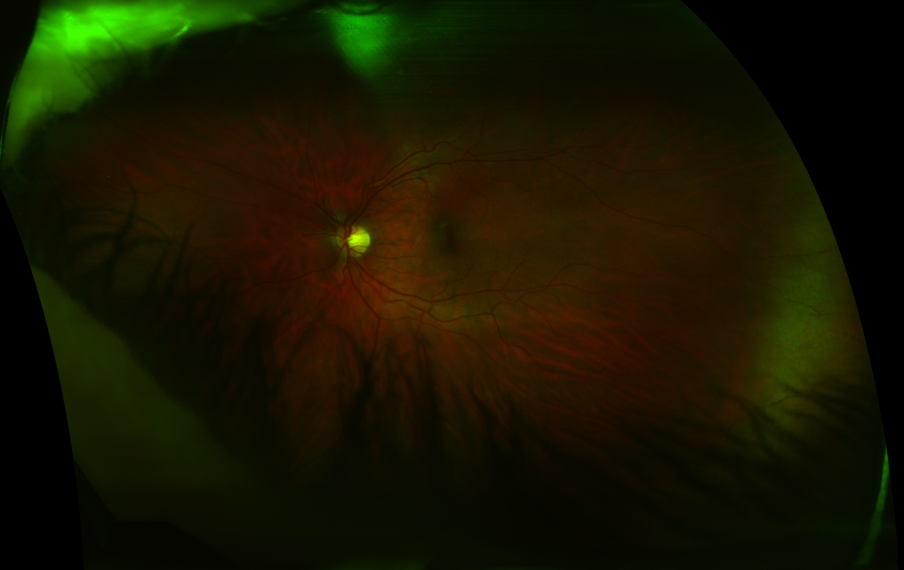
Left Eye

Slide 20
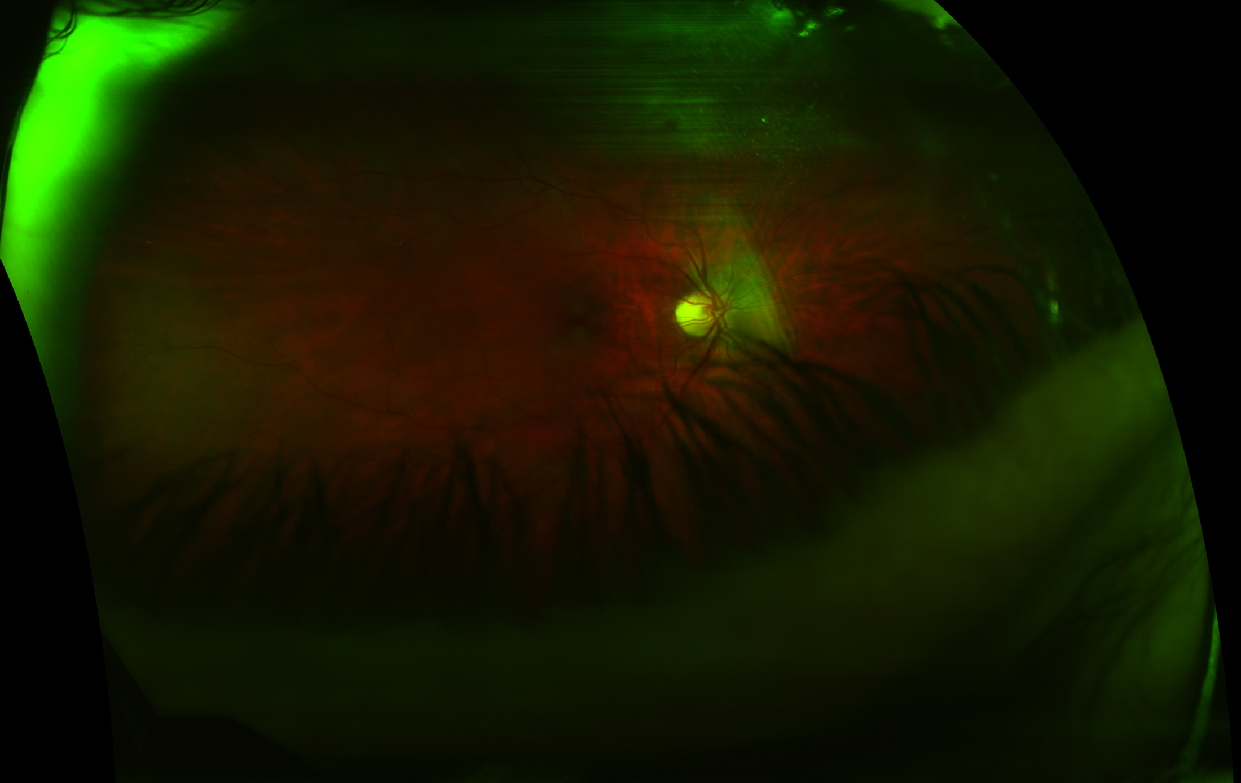
Right Eye

Slide 21
DSAEK - Descemet's Stripping Automated Endothelial Keratoplasty
http://www.youtube.com/watch?v=yOh_4hG8gJw

Slide 22
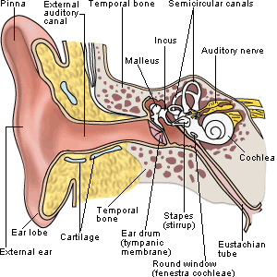
Anatomy of the Ear
Outer Ear:
Auricle / pinna – ear
External acoustic meatus / auditory canal – chamber into skull
Ceruminous glands – secrete cerumen (earwax)
Tympanic membrane - eardrum

Slide 23
Middle Ear
Middle Ear:
Oval window
Round Widow
Three bones (ossicles):
Malleus (hammer)
Incus (Anvil)
Stapes (Stirrup)

Slide 24
Inner Ear
Osseus Labyrinth –
Cochlea – spiraling structure
Vestible
Semicircular canals
Filled with perilymph

Slide 25
Hearing
What is sound?
Sounds are traveling vibrations / mechanical energy
2. Amplitude – corresponds to loudness / height of wave (AM)
3. Frequency – number of waves per second / pitch (FM)

Slide 26
Sensory Reception
External flaps of outer ear collect sound waves and direct them into auditory canal to ear drum
Sounds waves make drum vibrate. Bones of middle ear pick up vibrations and amplify stimulus. Moves waves of pressure to oval window (entrance to inner ear)
Oval window vibrations move fluids within inner ear. Causes membrane in cochlea to vibrate and sort out frequencies.
Vibrations then move hair cells that when bent, generate action potential. Send stimulus along auditory nerve (VIII) to brain.

Slide 27
Hearing

Slide 28
Equilibrium
Dynamic Equilibrium
Receptors in semicircular canals
Detect accelerated, rotational movement of head
Fluid in semicircular canals displaced with movement
Hairs detect movement and relay positional info to brain by vestibular branch of auditory nerve
Static Equilibrium
Activated by starts and stops in straight movement
Controlled in floor of vestibular apparatus
Otoliths or “ear stones” weigh down a membrane that is on top of hairs
When membrane slides due to linear acceleration, hairs bend; send info to brain

Slide 29
Physiology of Balance

