Slide 1
Skull Bones

Slide 2
28 Bones & Hyoid
6 single
11 paired

Slide 3
Cranium
Single
Frontal
Sphenoid
Ethmoid
Occipital
Paired
Parietal
Temporal

Slide 4
Face
Single:
Mandible
Vomer
Paired:
Maxillae
Zygomatic
Lacrimal
Inferior Nasal Conchae
Palatine

Slide 5
Auditory Ossicles (bones of the ear)
Malleous
Incus
Stapes

Slide 6
Frontal (1)
Markings:
Anterior Cranial Fossa
- Supports frontal lobes
Frontal Squama - Forehead
Supraorbital margins
- Thick bone at eyebrow
Glabella - flat area between orbits
Supraorbital foramen
- Passage for artery and nerves
Frontal sinuses
- lateral to glabella

Slide 8
Parietal (2)
On top lateral sides of skull
Sutures:
1. Coronal- parietal meets frontal
2. Sagittal- parietal meets parietal
3. Lamboidal- parietal meets occipital
4. Squamous- parietal meets temporal

Slide 9
Sutures

Slide 10
Occipital (1)
Posterior cranial fossa-supports cerebellum
Foramen Magnum- connects with spinal cord
Hypoglossal canals- passage for hypoglossal nerves
Occipital Condyles- permits “nodding” motion

Slide 11
Occipital bone (posterior)

Slide 12
Occipital markings

Slide 13
Temporal (2)
Zygomatic process- posterior cheek
Mandibular Fossa- forms part of the TMJ (temporal mandibular joint)
External Auditory Meatus- ear hole
Styloid Process- attaches tongue, neck muscles and hyoid bone
Mastoid Process- anchors neck muscle
Stylomastoid Foramen- passage for facial nerves
Middle Cranial Fossa- supports temporal lobe

Slide 14
Temporal bone

Slide 15
Sphenoid (1)
Butterfly shaped bone that articulates with all other cranial bones
Sella Turcica- encloses pituitary
Greater Wings
Lesser Wings
Pterygoid processes- anchors chewing muscles
- Sphenoid sinus
Several foramen for passing vessels and nerves

Slide 16
Sphenoid Bone

Slide 17
Ethmoid (1)
Cribiform plate- roof of the nasal cavities
-has holes that allow passage for the olfactory nerves to pass into the brain (looks like a sieve)
Crista galli- secures brain to cranial cavity
(looks like a “rooster comb”)
Ethmoid Sinus

Slide 18
Ethmoid bone

Slide 19
Facial bones

Slide 20
Mandible
Body- chin
Alveolar margins- anchors teeth
Mental foramen- blood vessels and nerves to chin
-Rami- 2 uprights from body
-Mandibular notch- superior rami
-Coronoid process- insertion of temporalis muscle (anterior)
-Mandibular condyle- articulates with temporal bone at TMJ (posterior)
-Mandibular foramina- medial surface of rami, nerves to lower teeth (novacaine area)

Slide 21
Mandible

Slide 22
Maxillary
Alveolar Margins- hold upper teeth
Palatine process- anterior, 2/3 of hard
palate
Frontal process- part of the bridge of the nose
Maxillary sinus- largest sinus

Slide 23
Maxillary (2)

Slide 24
Maxillary inferior view

Slide 25
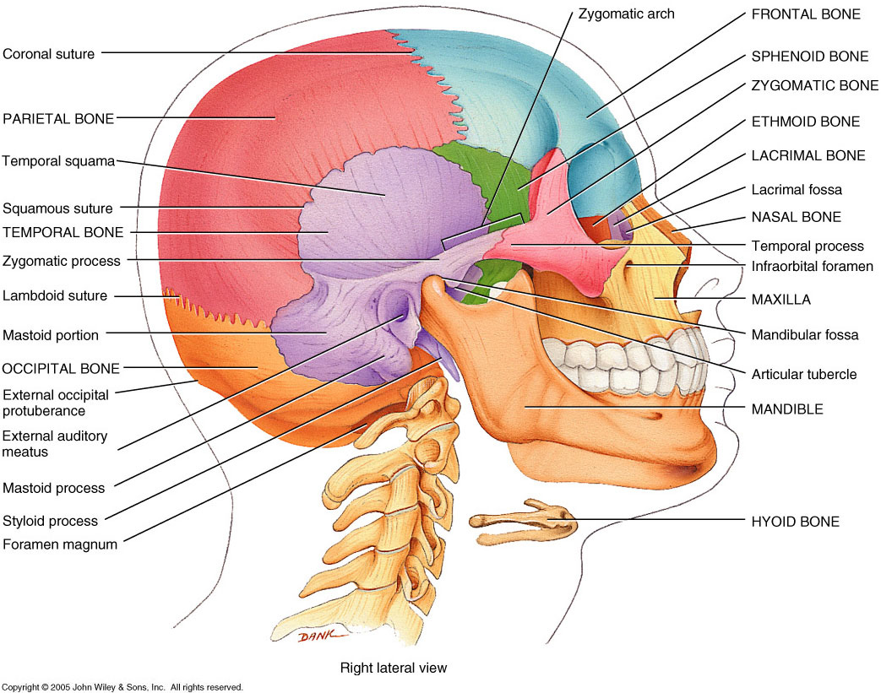
Zygomatic (2)
Cheekbones- articulates with temporal (posterior) and maxillary (anterior)

Slide 26
Nasal bones (2)
Fused medially to form the bridge of the nose

Slide 27
Lacrimal (2)
Delicate, form the medial wall of orbit
Lacrimal fossa- house tear ducts

Slide 28
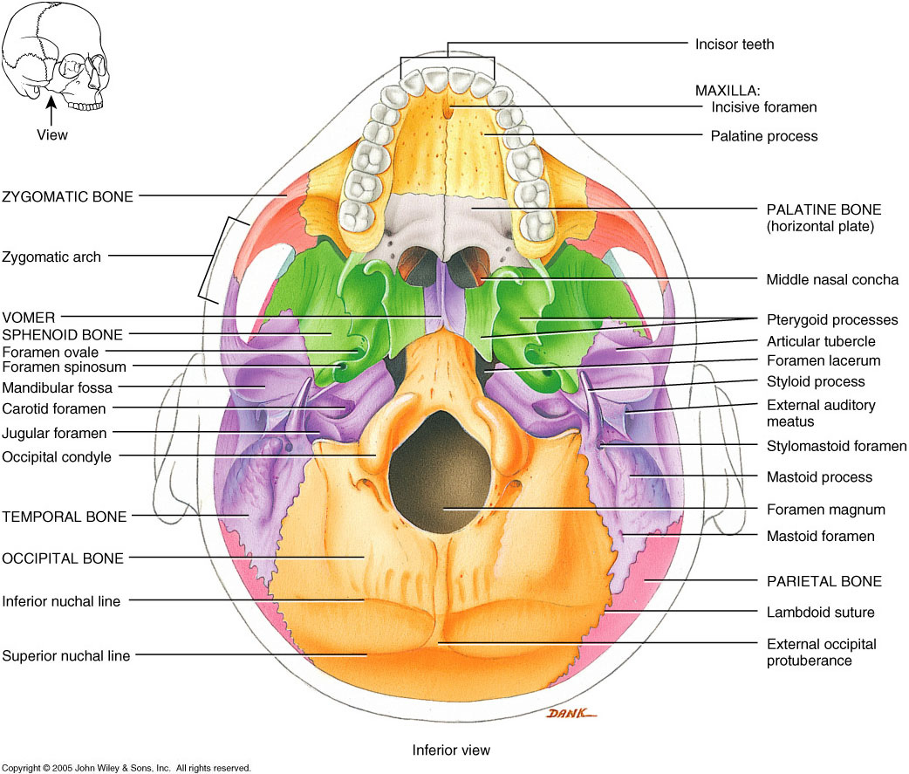
Palatine bones (2) -posterior hard palate

Slide 29
Vomer (1)
Plow shaped, part of nasal cavity

Slide 30
Inferior Nasal Conchae (2)
Part of the nasal cavity

Slide 31
Sinuses
-Paranasal-around nasal cavity
-Function- lighten skulls, enhances voice, warms and humidifies inspired air
-Maxillary
-Frontal
-Sphenoid
-Ethmoid

Slide 32
Hyoid (1)
In the anterior neck, moveable, the only bone that is not articulating with another bone
Holds the tongue

Slide 33
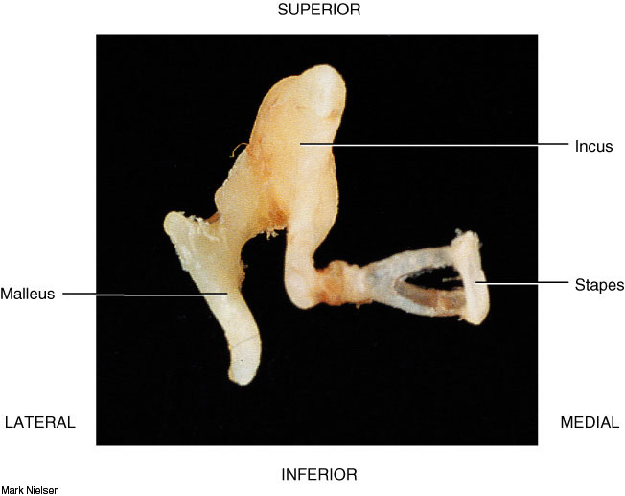
Auditory Ossicles
Malleus
Incus
Stapes
Tiny ligaments, join in a chain
Transmit vibration from eardrum

Slide 34
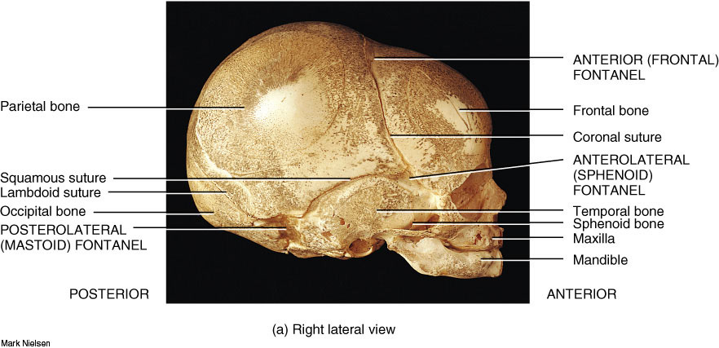
Fetal Skull- very thin, incomplete
Allows passage thru birth canal
Allows brain growth

Slide 35
-Birth-cranium is huge compared to facial bones
-From ages 6-11, the face grows
-Jaws, nose, cheekbones, become prominent
-Respiratory passages and permanent teeth develop

Slide 36
Wormian Bones
Tiny irregularly shaped bones that appear in suture lines
Vary among individuals
Unimportant

