Slide 1
Photosynthesis

Slide 2
Energy and Life

Slide 3
Autotrophs and Heterotrophs
Autotrophs: organisms that can make their own food
Use of light or chemical energy
Also called producers
Heterotrophs: obtain energy from eating other organisms
Also called consumers

Slide 4
Cellular Energy
ATP = adenosine triphosphate
ATP stores and transfers energy around the cell
For a very short period of time
Made up of:
Ribose
Adenine
Three phosphates
When ATP releases energy it becomes ADP, Adenosine diphosphate
Breaks a phosphate bond

Slide 5
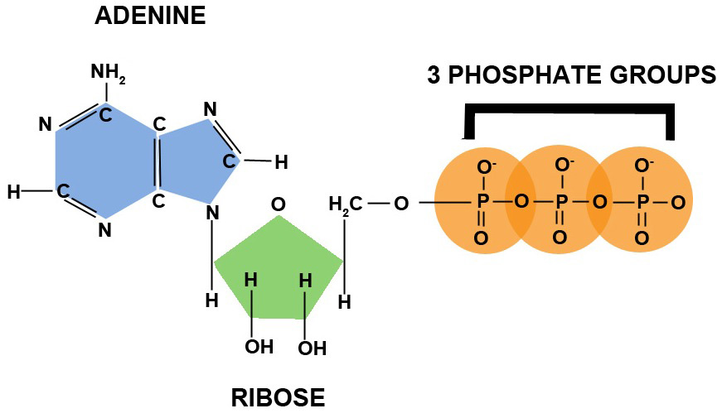
ATP to ADP
Adenosine Triphosphate

Slide 6
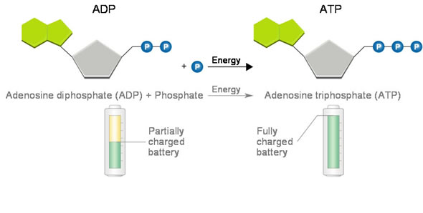
ATP Synthase
Making ATP from ADP and a phosphate group.

Slide 7
Photosynthesis: An Overview

Slide 8
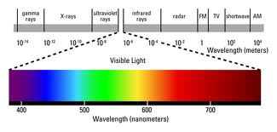
Photosynthesis
Capture energy from the sun to make sugars
Plants absorb visible light
Visible light has a spectrum
Looks white, but actually many colors

Slide 9
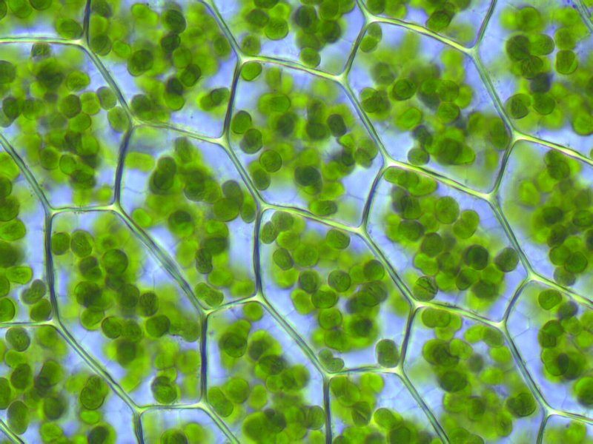
Chlorophyll
Pigment in plants to absorb light
Chlorophyll a and chlorophyll b
ALSO: carotenoids: yellow/orange pigments
Absorbs mostly red and blue light
Reflects back green light – so plants look green

Slide 10
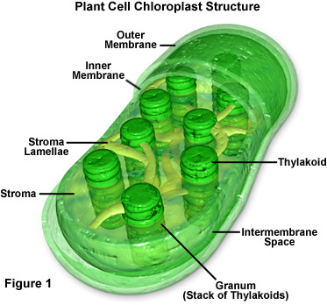
Chloroplasts
Organelle in plant cells needed for photosynthesis
Double membrane
Two parts
Grana
Stroma

Slide 11
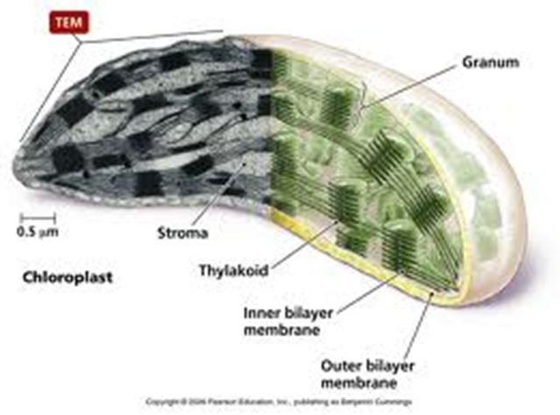
Grana
Stacks of membrane-enclosed compartments called thylakoids
Membrane of thylakoids contain chlorophyll

Slide 12
Stroma
Fluid that surrounds the grana

Slide 13
NADPH
Carry or transfer high energy electrons throughout the cell
NADP+ (Nicotinamide adenine dinucleotide phosphate)
Accepts and carries two electrons and one hydrogen ion (H+)
Turns NADP+ into NADPH
One way to capture light energy so the cell can use it

Slide 14
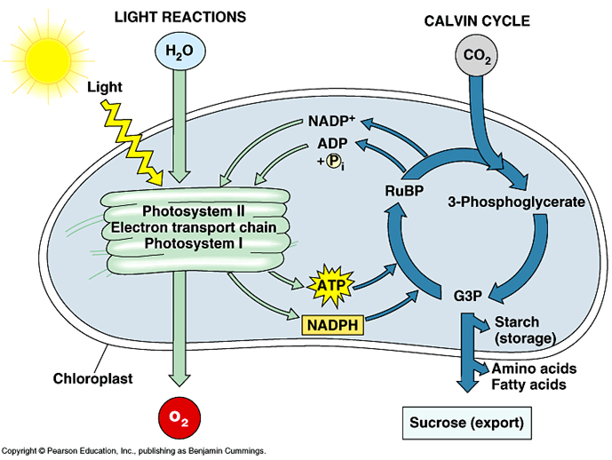
Photosynthetic Reaction
Light-dependent reactions
Light-independent reactions

Slide 15
Light-dependent reaction
Capture energy from the sunlight
Photosystem II absorbs light first
Within and across the thylakoid membranes
Needed materials: water, sunlight
Releases oxygen
Produces ATP, NADPH

Slide 16
Light-independent reactions
Also called: Calvin Cycle, Dark reactions
Uses energy from light-dependent reactions to make sugars
Occurs in stroma
ATP, NADPH, CO₂ is needed
Glucose is made

Slide 17
Balanced Photosynthetic Equation
6CO₂ + 6H₂O + energy → C₆H₁₂O₆ + 6O₂

Slide 18
Photosynthesis

Slide 19
Factors Affecting Photosynthesis
Amount of water
Plants in dry environments have waxy cuticle on leaves to prevent water loss
Temperature
Functions best between 0 C and 35 C
Enzyme function is affected outside of this range
Light intensity
More light, more photosynthesis until plant maxes out productivity

Slide 20
Photosynthesis MiniQuiz
What is chlorophyll?
Describe NADPH and NADP+
Name the two parts of photosynthesis
Where do they occur?
What is needed for photosynthesis to occur?
What is released at the end of the photosynthetic reaction?
Write the balanced equation for photosynthesis.
What three factors affect the rate of photosynthesis?

