Slide 1
CLASSIFICATION
TAXONOMY

Slide 2
Biology B-Day: 8/19/19
Bellringer:
What do you think classification means?
What classification kingdom do we fall into?
Agenda:
Bellringer
Classification Cut & Paste Activity
Classification Guided Notes
Reminder: Signed safety contract, syllabus and lab fee!!

Slide 3
Biology B-Day: 8/19/19
Bellringer:
What do you think classification means?
Organizing/grouping organisms based on similar characteristics
What classification kingdom do we fall into?
Kingdom Animalia
Agenda:
Bellringer
Classification Cut & Paste Activity
Classification Guided Notes
Reminder: Signed safety contract, syllabus and lab fee!!

Slide 4
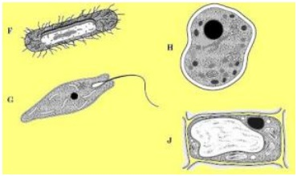
Biology B-Day: 8/21/19
Bellringer
How is the prokaryotic cell in the diagram different from a eukaryotic cell?
it has ribosomes to make proteins
It stores its genetic information in DNA
c) It has no membrane- bound nucleus
d) It has a cell membrane
Agenda
Bellringer
Classification Notes
Salamander Dichotomous Key
Amoeba Sisters Video

Slide 5
Biology B-Day: 8/21/19
Bellringer
How is the prokaryotic cell in the diagram different from a eukaryotic cell?
it has ribosomes to make proteins
It stores its genetic information in DNA
c) It has no membrane- bound nucleus
d) It has a cell membrane
Agenda
Bellringer
Classification Notes
Salamander Dichotomous Key
Amoeba Sisters Video

Slide 6
Characteristics of living things
1. all living things have DNA
2. all living things are made up of cells
3. all living things obtain/use energy
4. all living things need to adapt/evolve
5. all living things respond to a stimulus
6. all living things maintain homeostasis
7. all living things reproduce
8. all living things grow and develop

Slide 7
Characteristics of Life Videos:
http://www.exploratorium.edu/imaging_station/students/c_elegans.html
http://www.exploratorium.edu/imaging_station/students/sea_urchins_div.html
http://www.exploratorium.edu/imaging_station/students/sea_urchins_fert.html
http://www.exploratorium.edu/imaging_station/students/blood_cells.html
http://www.exploratorium.edu/imaging_station/students/cell_struct_funct.html
http://www.exploratorium.edu/imaging_station/students/stem_cells.html
http://www.exploratorium.edu/imaging_station/students/cell_motility.html
http://www.exploratorium.edu/imaging_station/students/zebrafish.html

Slide 8
Homeostasis: ability of the body to maintain a stable equilibrium
Example: a person sweating when running or a dog panting

Slide 9
TERMS TO KNOW
CLASSIFICATION: process of dividing organisms into groups with similar characteristics
TAXONOMY: the science of classifying living things

Slide 10
Reasons for classifying living things
Need for order and organization so information is easier to find.
Logical universal means for naming organisms is needed.
Organisms may be identified if they are classified by their characteristics.

Slide 11
CLASSIFICATION KEY:
tool used to identify organisms using their characteristics
Also called a DICHOTOMOUS KEY

Slide 12
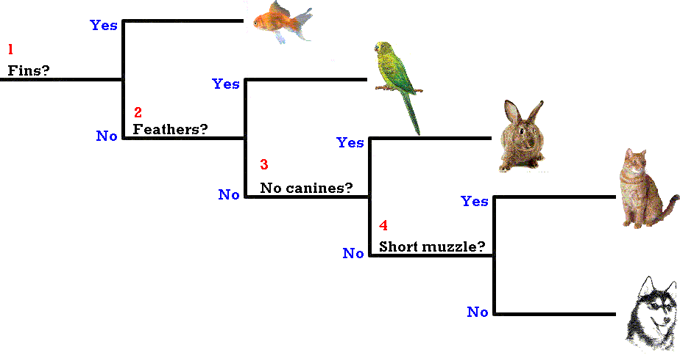
Classification of pets

Slide 13
Development of Taxonomy
A natural way of classifying organisms is based on the way organisms look and how they live.
Aristotle devised the first classification system over 1000 years ago.
Swedish botanist Carolus Linnaeus developed a classification system based on structural similarities during the 1700’s.

Slide 14
Linnaeus divided all organisms into two major groups called KINGDOMS, which he divided into smaller and smaller groups.

Slide 15
Kingdom Less SPECIFIC
Phylum
Class
Order
Family
Genus
Species More SPECIFIC

Slide 16
SPECIES: organisms that are similar in structure and appearance, can breed successfully, and have the same number of chromosomes.
VARIETIES or BREEDS: groups of slightly different organisms in the same species.

Slide 17
Binomial Nomenclature
Linnaeus also introduced a system of naming organisms called BINOMIAL NOMENCLATURE.
In binomial nomenclature the first name is the genus to which the organisms belongs, the second name is the species name of that organism.
The genus name is CAPITALIZED; the species name is lower case.
Scientific names are always underlined or italicized.
EXAMPLE→ Genus species
Homo sapien (man)

Slide 18
Linnaeus used Latin names because:
It is the language of scientists around the world.
It is studied and written, but not spoken.
It is descriptive and the root of many other languages.

Slide 19
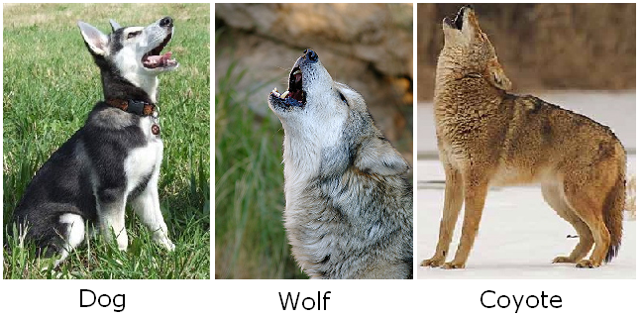
EXAMPLES of scientific names→
Canis familiaris → domestic dog
Canis lupus → wolf
Canis latrans → coyote

Slide 20
Common names are confusing because:
The same organism may have many common names.
Common names are misleading.
Common names vary with different languages.

Slide 21
Common names: mountain lion, puma, cougar, panther.
Scientific name: Felis concolor

Slide 22
Modern Taxonomy
Modern taxonomy is based on genetic similarities and the theory of evolution.
If two organisms have the same number of chromosomes and the chromosomes are similar in form, then the organisms are closely related.
The greater similarities in DNA, the closer relationship between organisms.

Slide 23
DOMAIN: largest division of taxonomy, based on differences between prokaryotes and eukaryotes.
Prokaryotes have NO nuclear membrane surrounding their genetic material, while eukaryotes have a nuclear membrane surrounding their genetic material to form a nucleus.

Slide 24
DOMAIN ARCHEA: (Kingdom Archeabacteria) prokaryotic organisms that live in extreme environments; halophiles (organisms which thrive in highly salty environments) and hyperthermophiles (organisms which thrive in extremely hot environments) are examples.
DOMAIN BACTERIA: (Kingdom Eubacteria) common prokaryotic organisms found almost everywhere; bacteria (heterotrophic carbon-eating prokaryotes) and cyanobacteria (autotrophic photosynthetic prokaryotes) are examples.
DOMAIN EUKARYOTE: eukaryotic organisms that are most of the world's visible living things; the kingdoms Protista, Fungi, Plantae, and Animalia are examples.

Slide 25
The FOUR KINGDOMS of the DOMAIN EUKARYOTA
KINGDOM PROTISTA: unicellular organisms EX: protozoa and simple algae.
KINGDOM FUNGI: multicellular organisms that are plant like, but cannot make their own food. EX: molds and mushrooms.
KINGDOM PLANTAE: multicellular, which can make their own food through photosynthesis; grasses, trees and flowering plants.
KINGDOM ANIMALIA: motile, multicellular, ingest food; sponges, insects, worms, fish, reptiles, birds, mammals.

Slide 26
Animal Kingdom Phyla:
Mollusca: water living, soft bodies, covered by a hard shell—ex: snails, clams
Porifera: pore bearing animals, marine habitats—ex: sponges
Cnidaria: shaped like a polyp, marine habitats, one opening for digestion---ex: jellyfish, coral
Platyhelminthes: flatworms, found in ponds and lakes
Annelida: bilaterally symmetrical, segmented worms or ringed worms
Arthropoda: inverterbrate with exoskeleton made of chitin, a segemented body—ex: insects, arachnids
Echinoderma: radial symmetry—ex: starfish, sand dollar
Chordata: vertebrates, possess notochord—ex: fish, amphibians, reptiles, birds and mammals

Slide 27
Biology B-Day 8/26/19
Bellringer
How do we use a dichotomous key?
What are the two parts of binomial nomenclature?
Agenda
Bellringer
Finish Salamander Key
Amoeba Sisters Video
Characteristics of Life Stations

Slide 28
Biology B-Day 8/26/19
Bellringer
How do we use a dichotomous key?
Looking at similar characteristics
What are the two parts of binomial nomenclature?
Genus species
Agenda
Bellringer
Finish Salamander Key
Amoeba Sisters Video
Characteristics of Life Stations

Slide 29
Plant Phyla:
Bryophyta: flowerless, grow in damp, shady locations in clumps—ex: mosses
Filicinophyta: terrestrial, vascular plants—ex: ferns
Conifers: gymnosperms, cone-bearing, seed plants—ex: cedars, douglas-firs
Angiosperms: flowering plants, land plants, fruit production—ex: daisies, lillies, oak trees

Slide 30
Viral Structure and Classification
VIRUS: a biological particle composed of genetic material (DNA or RNA) encased in a protein coat
CAPSID: protein coat surrounding a virus
OBLIGATE INTRACELLULAR PARASITE: biological particle that requires a host cell to reproduce

Slide 31
VIRUSES ARE NOT CONSIDERED TO BE LIVING ORGANISMS BECAUSE
They do not reproduce by mitosis or meiosis.
They cannot carry out cellular respiration.
They have no nucleus, cytoplasm, organelles, or cell membrane
They require a host cell to use organelles and enzymes to reproduce more viruses.
Outside a host cell a virus is a lifeless particle with no control over its own movement.

Slide 32
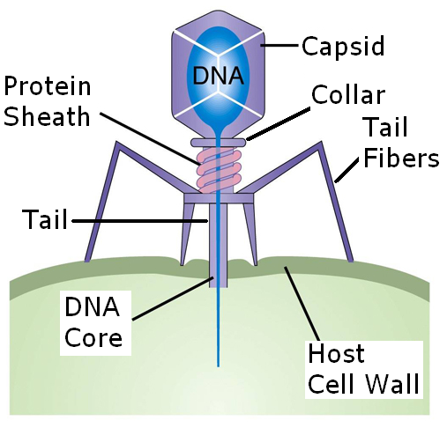
Viral capsids may have different shapes, but the most common is the icosahedron.
ICOSAHEDRON: viral capsid shape that is a polyhedron with 20 triangular sides.
Example - cold, polio

Slide 33
To Earn Points Back:
Give me 1 characteristic and an example of each phyla
Annelida, Echinodermata, Arthropoda, Chordata, Mollusca, Cnidaria, Platyhelminthes, Porifera

Slide 34
Biology B-Day 8/28/19
Bellringer
Which of the following characteristics would most-likely place an organism within the kingdom Animalia?
a. lack of photosynthesis
b. unicellular
c. ability to photosynthesize
d.presence of a cell wall
____ is the classification system in which each species is assigned a two part scientific name.
Agenda
Bellringer
Parts of a cell notes
Parts of a cell video
Eukaryotic vs. Prokaryotic

Slide 35
Biology B-Day 8/28/19
Bellringer
Which of the following characteristics would most-likely place an organism within the kingdom Animalia?
a. lack of photosynthesis
b. unicellular
c. ability to photosynthesize
d.presence of a cell wall
___Binomial Nomenclature_ is the classification system in which each species is assigned a two part scientific name.
Agenda
Bellringer
Parts of a cell notes
Parts of a cell video
Eukaryotic vs. Prokaryotic

Slide 36
Biology A-Day 8/29/19
Bellringer
Unlike plant cells, animal cells do not have this organelle that performs photosynthesis...
Ribosomes are responsible for synthesizing proteins…T/F
Agenda
Bellringer
Are Viruses Alive Article/Questions
Parts of Animal & Plant cells coloring

Slide 37
Biology A-Day 8/29/19
Bellringer
Unlike plant cells, animal cells do not have this organelle that performs photosynthesis...
Chloroplasts
Ribosomes are responsible for synthesizing proteins…T/F
TRUE
Agenda
Bellringer
Are Viruses Alive Article/Questions
Parts of Animal & Plant cells coloring

Slide 38
Biology B-Day 9/4/19
Bellringer
An increase in environmental temperature will cause a person to sweat and a dog to pant. After drinking a sugary drink, the body releases insulin to signal uptake of glucose by body cells. These are both examples of…
Which classification index comes before order?
Agenda
Bellringer
Finish Last Class Activities
Eukaryotic vs. Prokaryotic

Slide 39
Biology B-Day 9/4/19
Bellringer
An increase in environmental temperature will cause a person to sweat and a dog to pant. After drinking a sugary drink, the body releases insulin to signal uptake of glucose by body cells. These are both examples of… homeostasis
Which classification index comes before order?
Class
Agenda
Bellringer
Finish Last Class Activities
Eukaryotic vs. Prokaryotic

Slide 40
Biology B-Day 9/6/19
Bellringer
All vertebrates share which characteristic?
What is the function of mitochondria?
Agenda
Bellringer
Finish Last class activities
Finish Notes
3-point paragraph

Slide 41
Biology B-Day 9/6/19
Bellringer
All vertebrates share which characteristic?
Spinal Cord
What is the function of mitochondria?
Perform cellular respiration to make ATP
Agenda
Bellringer
Finish Last class activities
Finish Notes
3-point paragraph

Slide 42
Biology A-Day 9/9/19
Bellringer
What is the correct order of classification levels?
Unlike plant cells, animal cells do not have…
Agenda
Bellringer
Finish any activities
Review for exam

Slide 43
Biology A-Day 9/9/19
Bellringer
What is the correct order of classification levels?
Kingdom, phylum, class, order, family, genus, species
Unlike plant cells, animal cells do not have…
Cell wall or chloroplasts
Agenda
Bellringer
Finish any activities
Review for exam

